Slide 1
Campus: Log-in with Institutional Email Domain

Slide 2
Guide for first log-in
Step 1a
Log in via new MyKarger account
Step 2
Access courses
Step 1b
Log in via existing MyKarger account

Slide 3
Guide for first log-in
Step 1a
Log in via new MyKarger account
Step 2
Access courses
Step 1b
Log in via existing MyKarger account

Slide 4
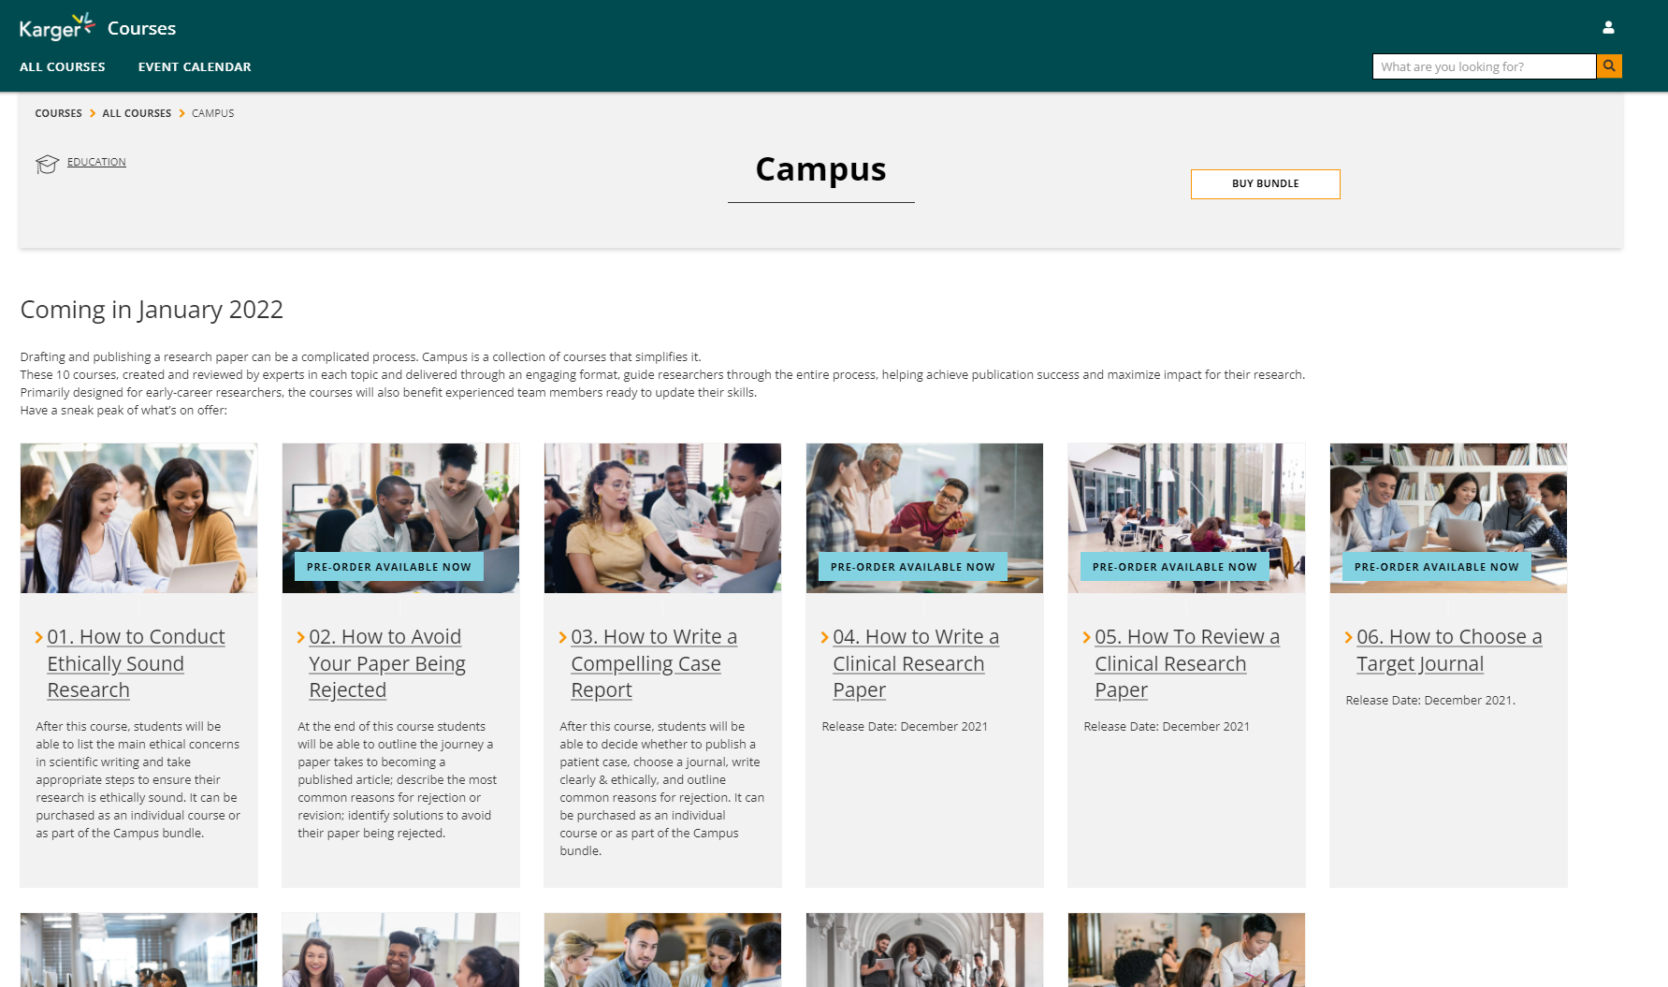
Step 1a
Go to www.karger.com/campus and click ‘buy bundle’

Slide 5
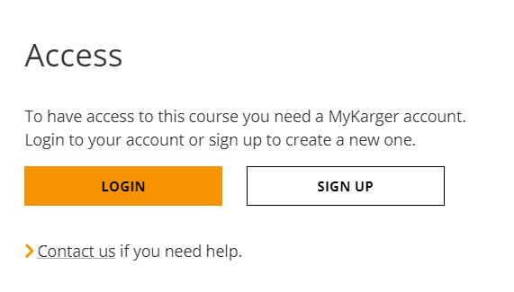
Step 1a
Create a MyKarger account by clicking ‘sign up’

Slide 6
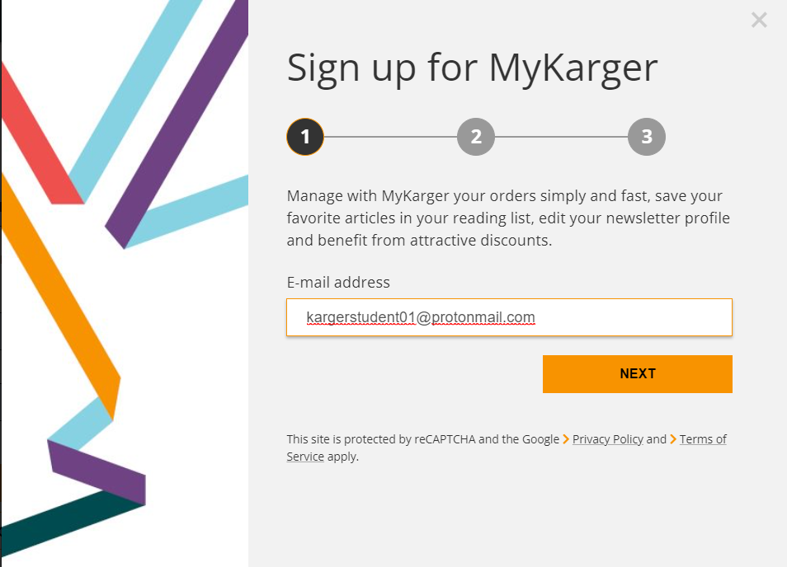
Step 1a
Enter your email address
Important:
Sign up with your institutional email domain (e.g. @unibasel)

Slide 7
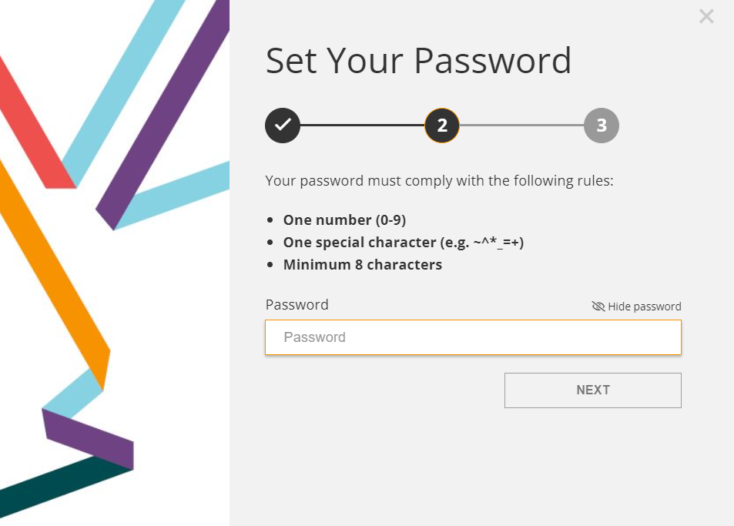
Step 1a
Choose a password

Slide 8
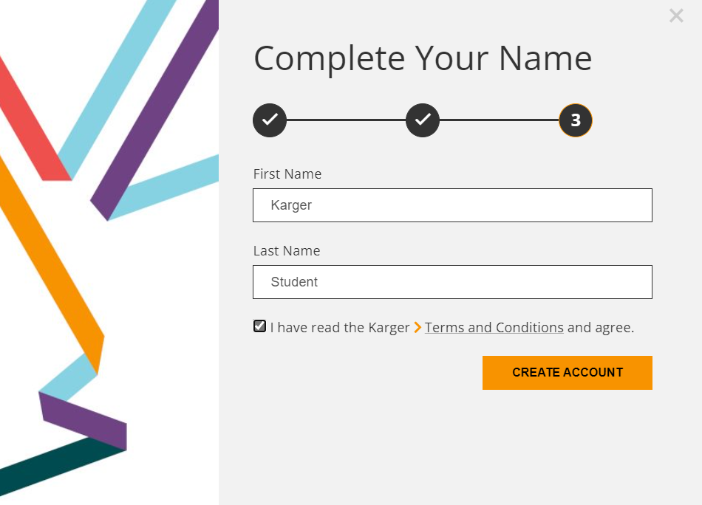
Step 1a
Enter your name and agree to the ‘terms and conditions’

Slide 9
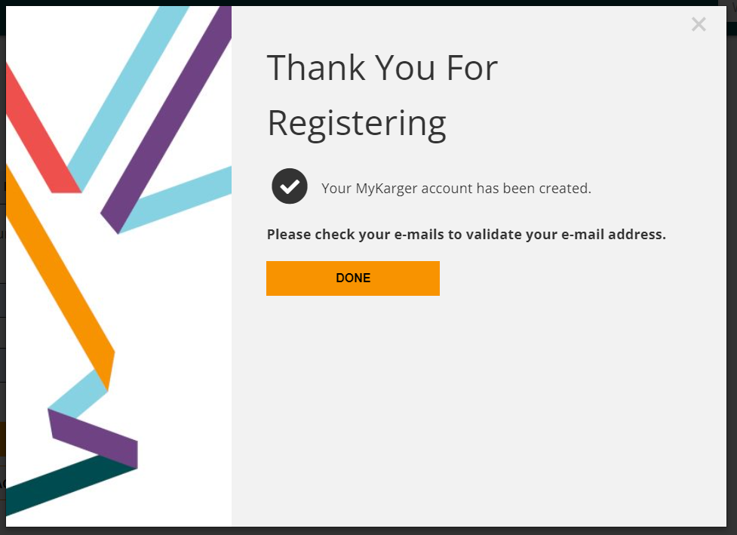
Step 1a
Click ‘done’

Slide 10
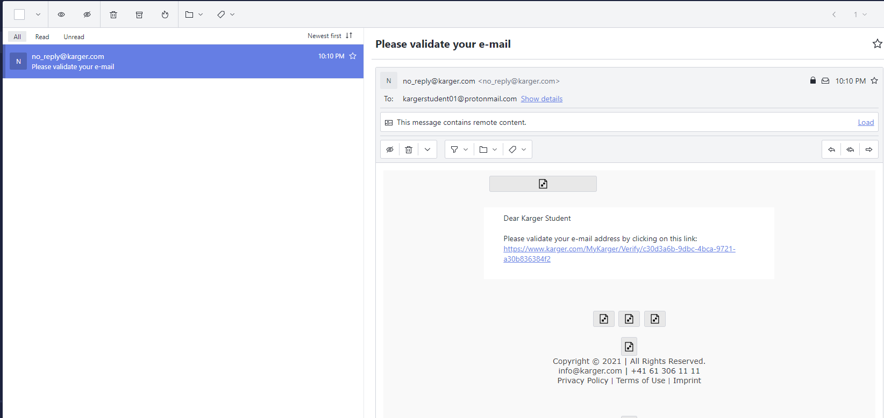
Step 1a
Click on link in email sent to your email address to validate

Slide 11
Guide for first log-in
Step 1a
Log in via new MyKarger account
Step 2
Access courses
Step 1b
Log in via existing MyKarger account

Slide 12
Step 1b
Go to www.karger.com/campus and log-in via existing MyKarger account

Slide 13
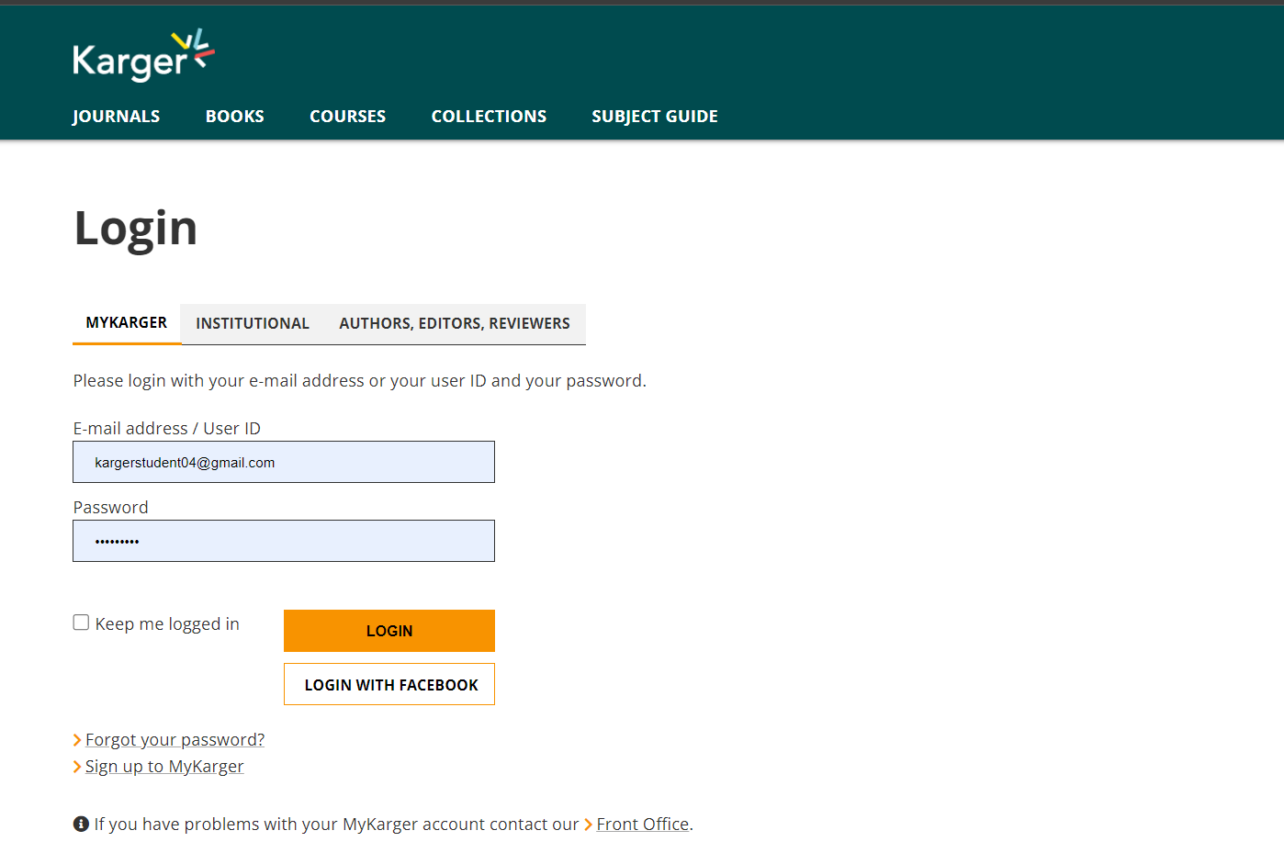
Step 1b
Enter your MyKarger log-in details

Slide 14
Guide for first log-in
Step 1a
Log in via new MyKarger account
Step 2
Access courses
Step 1b
Log in via existing MyKarger account

Slide 15
Step 2
Access to all Campus courses on dashboard
Click on the course you want to start

Slide 16
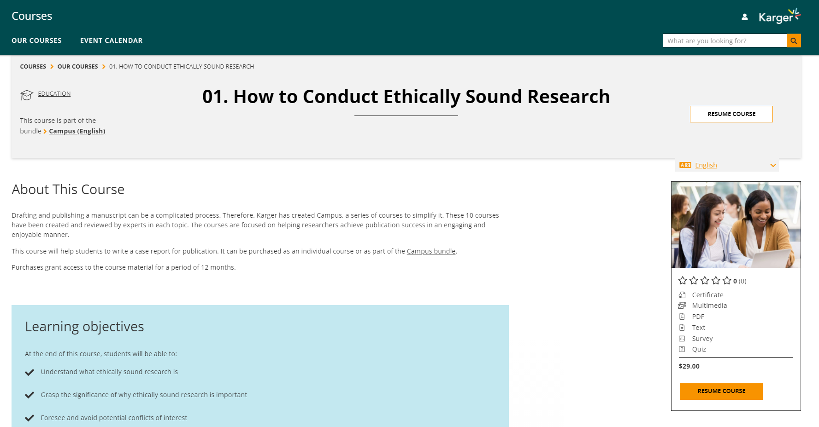
Step 2
Access to all Campus courses on dashboard
Click on ‘resume course’.
Note: ‘Resume’ is indicated because you were automatically enrolled
The price still appears after access is granted, but can be ignored. No charges will apply.

Slide 17
If you have any log-in or access issues please contact us for assistance. campus@karger.com

